Slide 1

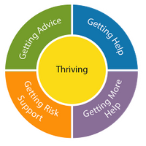
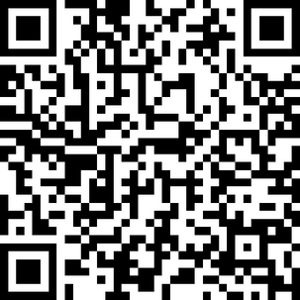






Welcome to HertsHub!
www.hertshub.co.uk
Hertfordshire’s Children and Young People’s
Mental Health and Emotional Wellbeing Hub
Helping young people, parents, carers and professionals find the right help at the right time:
    Advice
    Self-help
    Information and signposting to services
Hertfordshire’s Children and Young People’s
Mental Health Services (CYPMHS) System

