Slide 1
What does it mean to be an asthma friendly school?
Dr avani dEVKARAN

Slide 2
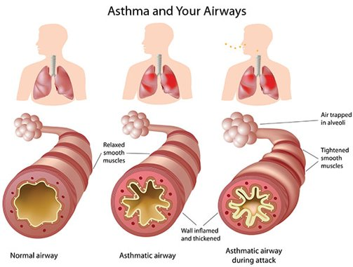
Asthma: WHY DOES IT MATTER?
Asthma is the most common long-term medical condition in children in the UK, with around 1 in 11 children and young people living with asthma.
It is a chronic condition; it can not be cured. Appropriate management can improve QOL.
The UK has one of the highest prevalence, emergency admission and death rates for childhood asthma in Europe.
3 Asthma deaths every day: 2/3 of these deaths are preventable Asthma UK (2020)
in UK: 24% children with Asthma miss >6 school days each year
It impacts on care given within schools and early years settings. Appropriate asthma care is necessary for the child’s immediate safety, long-term well-being and optimal academic performance.
2010 Children, Schools and Families Act and the Children and Families Act 2014 introduce a legal duty on schools to look after children with medical conditions.
Notes:
Whilst some older children may be fully independent with their condition, younger children, children with learning difficulties or those newly diagnosed are likely to need support and assistance from school staff during the school day, to help them to manage their asthma in the absence of their parents.

Slide 3
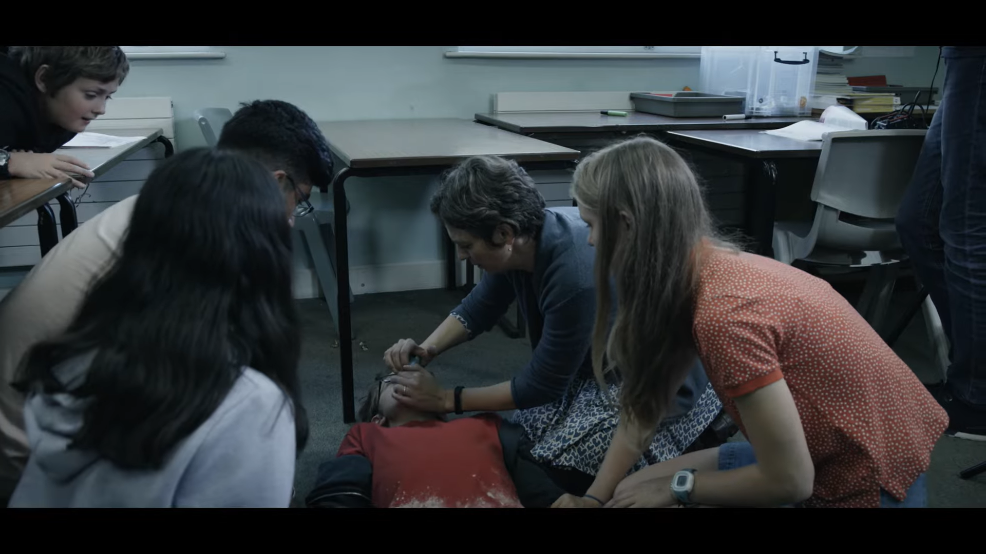
Asthma: WHY DOES IT MATTER?
Preventable. A short film about asthma – YouTube

Slide 4
What DO Schools Need to do?
Named ‘Asthma Champion’ – individual responsible for asthma in school. Not same as school nurse
Responsible for linking with community asthma services
Attends annual Schools Asthma Workshop
Tier 1 Training for staff members
Register of all known asthmatics
Clear asthma policy
Management plan for known asthmatics
Display of emergency plan
Access to emergency inhalers
Provide EVIDENCE TO ICB

Slide 5
Support and resources available
HWE ICB Resource pack for schools
- Include sample letter for parents about AFS
- Sample asthma plan (INDVIDUAL TO CHILD)
- Sample emergency inhaler policy
- School asthma Register
- record of emergency Inhaler Administration
- Letter to inform PARENT OF SALBUTAMOL USE
- Checklist for emergency asthma kit
- Record of school days missed due to asthma
- School nurses engaged and ready to help

Slide 6
More resources
London schools’ guide for the care of children and young people with asthma: Pre-school, primary and secondary school years - Transformation Partners in Health and Care
Asthma friendly schools - Transformation Partners in Health and Care
Schools - Beat Asthma
Asthma | Asthma + Lung UK
Asthma :: Hertfordshire and West Essex Healthier Together (hwehealthiertogether.nhs.uk)

Slide 7
Change a life today

