Slide 1

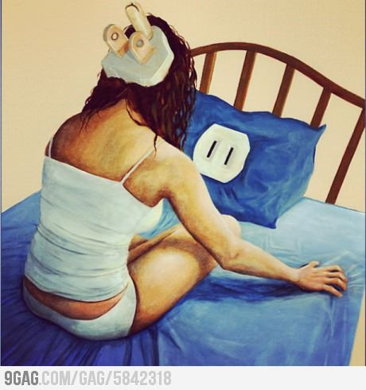
Sleep hygiene workshop April 2019
Dr Nirja Beehuspoteea and Marcia Knight

Slide 2

Objectives
What is sleep?
Why do we sleep?
How much sleep do we need?
Why is sleep important?
Why can it be hard to sleep?
What is Sleep Hygiene?
SLEEP HYGIENE
  Lifestyle skills
  Practical Skills
Summary + Feedback
Useful links and resources

Slide 3


Goals:
What are your current sleep difficulties impacting you?
What would you like to change?
How would your sleep be different?
We will be asking for feedback at the end of the session – please add your goal or goals to this sheet and rate where you are at now out of ten.

Slide 4

What is sleep?
An extended bout of rest we experience on a daily basis, where we are unconscious (unaware of what’s going on around us) and our brain, nerves and muscles go into “rest and recover”
Sleep is an active period in which a lot of important processing, restoration, and strengthening occurs.
Notes:
Nirja

Slide 5

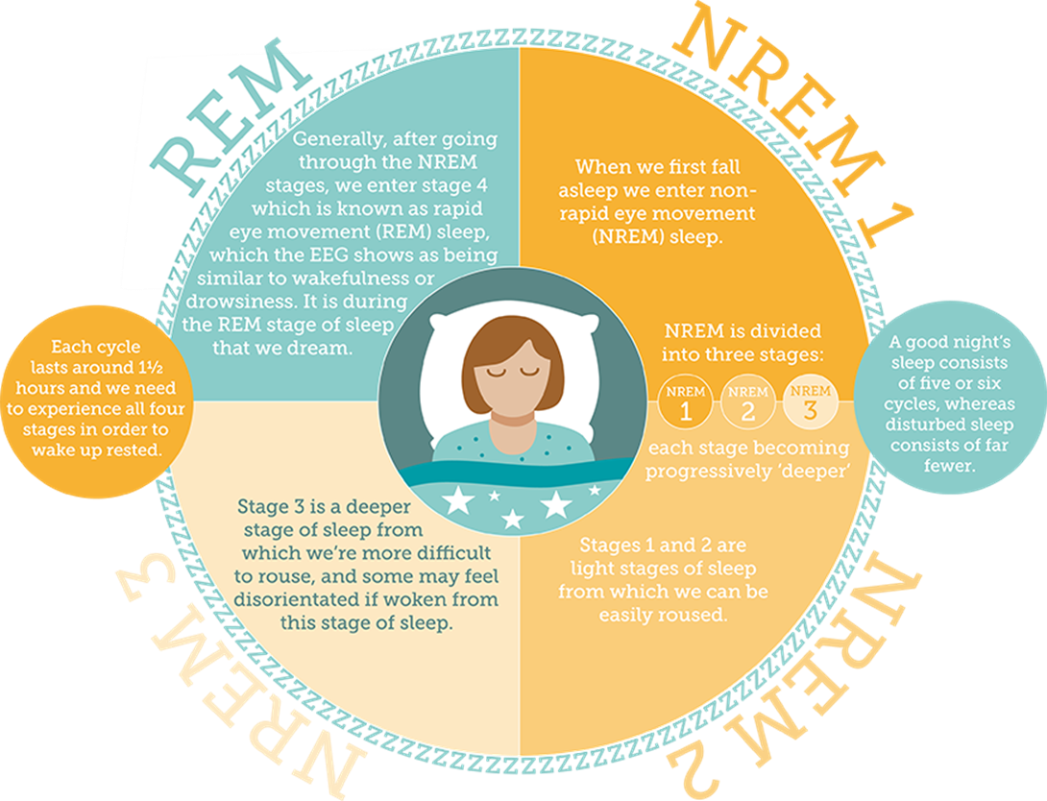
Notes:
Nirja

Slide 6
What is the circadian rhythm?
Circadian rhythm = internal body clock
Melatonin is a hormone that occurs naturally in our bodies during our circadian rhythm
  It is produced at night time to help us go to sleep
  Light in the morning signals to our brains to stop producing this hormone, meaning we feel less sleepy
  During adolescence, our circadian rhythm naturally shifts to later on at night, meaning that we find it hard to fall asleep earlier, and are more sleepy in the morning.
Notes:
Nirja
This means for teens it is even harder to get up in the morning as their rhythm is still in a ‘dip’ meaning they feel tired. This can then be made worse by the early start of the school day, increasing feelings of tiredness if they haven’t had enough sleep.
Teens get a bad rep but its actually their rhythms!

Slide 7

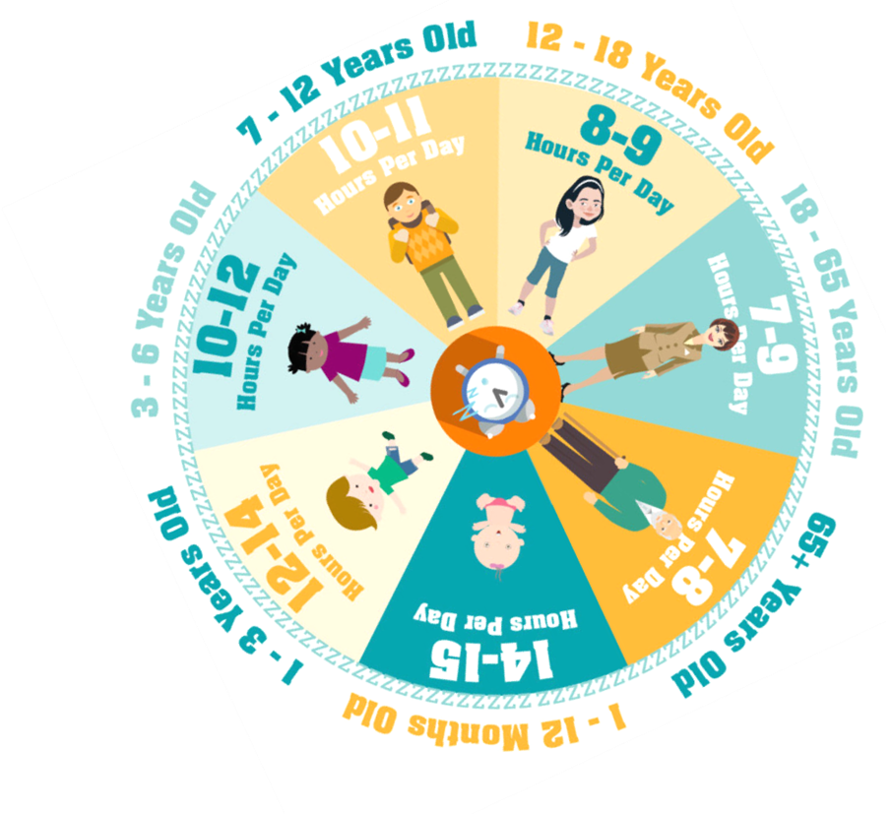
Notes:
Sleep cycles develop as we age, teens generally need more sleep than adults at 9 hours a night compared to 7/8.

Slide 8

Why do we sleep?
To process memories – organise and store memories of the previous day
To restore the body – replenish energy, grow muscle, heal tissue, and synthesize hormones.
To dream – no-one is yet sure why we dream!
Notes:
Nirja

Slide 9


Why is sleep important?
Good sleep = physical + mental wellbeing!
The occasional night without sleep will make you feel tired the next day, but it won't affect your health.
However, after several sleepless nights, you will start to find that you:
  feel tired all the time
  drop off during the day
  find it difficult to concentrate
  find it hard to make decisions
  start to feel low in mood
  start to worry about not being able to sleep
Notes:
Nirja
Healthy sleep is critical for everyone, since we all need to retain information and learn skills to thrive in life. But this is likely part of the reason young people—who acquire language, social, and motor skills at a breathtaking pace. During these critical periods of growth and learning, younger people need a heavy dose of sleep for optimal development and alertness.

Slide 10
Example exercise
Josh, 15 has been spending a lot of time at home during the summer holidays. He loves a lie-in and tends to wake up at about 11am-noon everyday. He has breakfast, then comes back to his bedroom to do some reading. He has convinced his parents to install a TV in his room and he watches TV in the afternoons while lying in bed. He goes downstairs for meals and occasionally to help his parents with chores but prefers staying in his room as it gets boring downstairs. He can also text and ring his friends upstairs without his little sister bothering him. He usually tries to get to sleep at about 11pm-midnight but doesn’t manage to fall asleep until 3 am most days. This has started to cause several arguments with his mum. He ends up feeling more tired and grumpy every day, which again causes more arguments. He wishes his mum could see his point of view.
What could Josh do to help the situation?
Notes:
Both
Ask them to have a chat in pairs/ person behind them
5 minutes?
Feed back and say we will be covering these things
Maybe point out anything they have missed
Flipchart?

Slide 11




What else can you think of?
Notes:
Highlight some examples that might be common – there are other things that can get in the way
What else can you think of?

Slide 12
Why can it be hard
to sleep?
The bedroom may be too noisy, messy, too hot or too cold
The bed may be uncomfortable or too small
Don't have a regular sleep routine
Aren't getting enough exercise
Eating too late - and finding it hard to get off to sleep
Going to bed hungry - and wake up too early
Cigarettes, alcohol and drinks containing caffeine, such as tea and coffee
Illness, pain, or a high temperature.
Notes:
Nirja – highlight anything they’ve missed

Slide 13
More long term reasons
Emotional problems
Anxiety and worry
Depression
Thinking over and over about problems - usually without getting anywhere with them
Physical problems – illness or disability
Medications that affect sleep

Slide 14

What is Sleep Hygiene?
Notes:
Sleep hygiene is a variety of different practices and habits that are necessary to have good night-time sleep quality and full daytime alertness – national sleep foundation

Slide 15
There have been lots of suggestions about what might help people get good sleep.
Different things work for different people.
Often these ideas don’t work straight away; you have to try them for a few nights first.

Slide 16

Your Bedroom
Lighting:
Make your room dark (use black out curtains)
Too much light can disrupt melatonin production needed for sleepiness
Technology:
Turn off all screens + LED displays an hour before bed
Technology gives off ‘blue light’ and can disrupt melatonin
Noises from phones can be distracting and tempting to look at when trying to get to sleep
Temperature:
If you’re too hot or too cold, you won’t sleep soundly. 16-18° C is ideal.

Slide 17
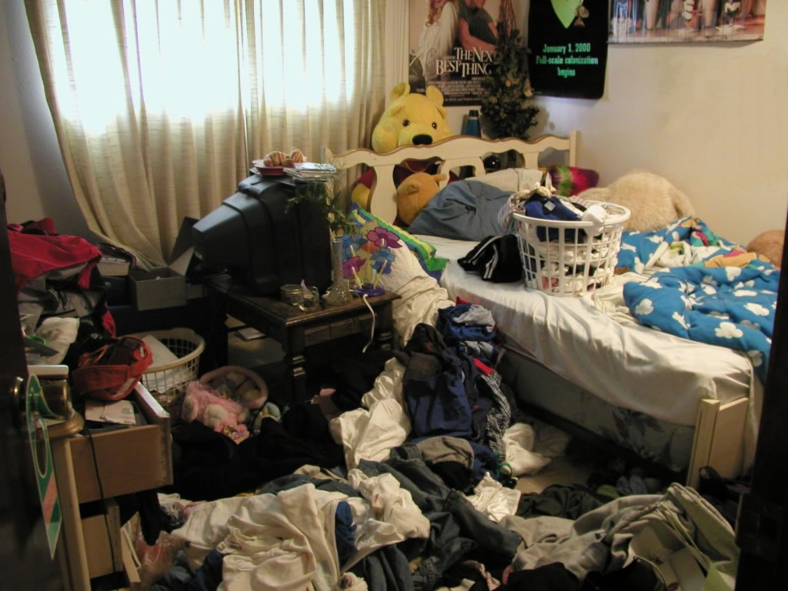
Notes:
Question – whose bedroom looks like this, or has seen something similar is someone you know?

Slide 18
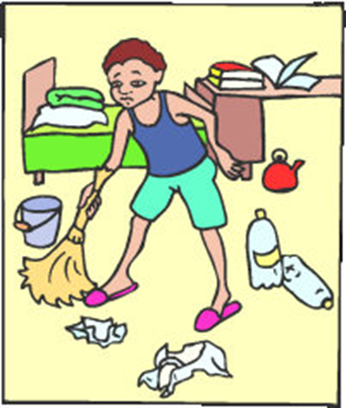
Relaxing:
  Make your room relaxing to you.
  Avoid treating your bedroom like an extension of the rest of your house. That means you shouldn’t use it for work, watching TV etc.
  Save the bedroom for sleep
  A tidy room makes for a tidy mind… and a restful night’s sleep!
  De-clutter your bedroom and make separate “zones” for play, work and sleep.

Slide 19

Your Bed
Make sure that your mattress supports you properly.
Generally, you should replace your mattress every 10 years to get the best support and comfort.
Notes:
If it's too firm, your hips and shoulders are under pressure. If it's too soft, your body sags which is bad for your back.

Slide 20

Your Lifestyle
Maintain a regular bedtime routine and sleep pattern
Try not to nap during the day
Include weekends in your routine
Avoid drinking alcohol or caffeine before bed.
  Stop drinking tea or coffee by mid-afternoon.
  If you want a hot drink in the evening, try something milky or herbal (check there's no caffeine in it).
  It can take 6 hours for half the caffeine in your system to wear off (National Sleep Foundation)
Notes:
- Don't go without sleep for a long time. Go to bed when you feel tired and stick to a routine of getting up at the same time every day (even weekends!), whether you still feel tired or not – if you still feel tired and need more sleep, gradually move your bedtime earlier forward.
- Having a solid bedtime routine allows your body to wind down and doing the same things at similar times each night start to signal to your body and brain that soon it will be time for sleep.
Napping during the daytime can make it harder to get to sleep at night.
Caffeine can hang around in your body for many hours, make sure you check and try to avoid caffeine in the run up to bedtime

Slide 21
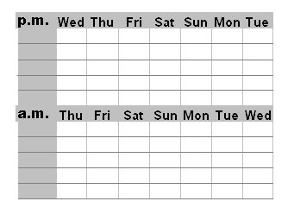
Try not to drink too much before bed and go to the toilet as part of your routine
This avoids waking in the night and disrupting your sleep cycle.
Keep a sleep diary for a week.
  You can look back and notice when you have or had not had a good night’s sleep, and make links between what you have done that day and how this might be impacting your sleep.
  Then you can start to do more of what helps, and less of what doesn’t.

Slide 22

Your Diet
Try to combine a protein food with a low to medium glycaemic index carbohydrate
Avoid stimulants like caffeine and cigarettes.
Avoid sedatives, such as sleeping pills and alcohol, to help you sleep.
Don’t buy melatonin supplements online.

Slide 23

Your Exercise Routine
It’s believed that exercising close to bedtime can disturb sleep.
Exercise before bed can feel like it might tire you out, but can actually make you more alert, meaning it is harder to get to sleep
  Gentle yoga exercises before bed may help to relax you, but won’t be too energetic
  Exercising earlier in the day can mean that you sleep better at night, with moderate aerobic exercise helpful for getting to sleep (such as walking)

Slide 24


Slide 25
Amy is 16 and is currently revising for GCSEs. She is finding it quite stressful and keeps worrying that she is not working hard enough and that she might fail her exams. She keeps thinking about what will happen if she fails, and she is worried about letting her parents down.
During the day, she tends not to think about it because she has so much to do, but when she lies in bed trying to fall asleep, all the worry comes back and she finds it difficult not to think about this. She keeps tossing and turning in bed and ends up spending the whole night sleeping in fits and starts, waking up really tired the next morning. This affects her concentration at school which makes her worry even more.
What could be helpful for Amy?

Slide 26
Soothing skills for in the moment
Progressive muscle relaxation
Breathing exercises
Thought banishing through speaking out loud
Problem solving

Slide 27
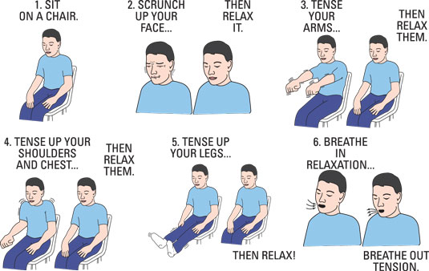
Progressive muscle relaxation
This technique helps you to notice the difference in sensation between being tensed and relaxed.
Try this before bed or when you are feeling stressed.
Practice this, slowly moving up your entire body.
Try it out!
Notes:
Using relaxation exercises can reduce any stress or tension we may be feeling, and help us to sleep better.
A number of things happen when we feel stressed – our heart rate increases, we have increased mental arousal, and often our breathing quickens, due to our natural fight or flight response. But when trying to go to sleep, we don’t need these responses, so using relaxation exercises to reduce these can help us sleep better.

Slide 28


Breathing exercises
Breathing slowly helps slow our heart rate.
This prepares your body for sleep by making sure you are not overly stimulated.
There are a few different exercises you can try:
Square breathing
Colour breathing
Balloon breathing
Notes:
We can use this technique to breathe mindfully – acknowledging any thoughts and feelings we are having during this time, but keeping our focus on breathing in and out and keeping ourselves in the present moment.
Colour breathing – your favourite or relaxing colour – breathing this in and letting to fill you, and breathing out a negative colour, or breathing out all of your thoughts. Focusing on imagining breathing this colour in
Square breathing – breathing in and out whilst tracing your fingers along the edge of an imaginary square, or following this with your eyes – helps control the pace of your breathing
Balloon breathing – imagine our chest has a balloon inside – we want to breathe in and imagine we are filling this balloon and it is inflating. Breathe so that our chests get bigger, not our stomachs

Slide 29

Speaking out loud
We can use speaking out loud to override any thoughts we have when trying to sleep.
This technique can help us to banish these unwanted thoughts; we can even use this technique to solve any problems that are keeping us from sleeping well.
Imagine you are trying to count in your head, and also say the alphabet out loud – you cant do both.
Notes:
Using our words to override thoughts because we cannot think and speak different things at the same time.
Experiment with the counting upwards/ alphabet task as an example.
Can use this technique in different ways:
Use this as problem solving time – speak out loud solutions to the thoughts in your head that may be keeping you awake
Use motivational phrases instead – instead of thinking ‘I am not going to do well on my exams’ say out loud ‘ I have tried my best and will do the best I can in my exams’

Slide 30

Worry time and problem solving
Having dedicated time each day to focus and try to problem solve our thoughts and worries can help us clear our minds.
If you find yourself worrying when you go to bed, write down your worries, and an action plan to solve these for tomorrow, then think:
“I cannot do any more right now to solve my worries, I will leave them until the morning.”
Getting our thoughts onto paper can sometimes help us feel like we are in more control, as they aren’t going round and round in our heads but are fixed on a page.
Notes:
You may be struggling to sleep due to worrying. This could be related to anxiety or depression, or you may be worrying about school, friends, or work. It can feel awful to be lying awake at night stressed or anxious. But there is something we can do about this:
Have dedicated time to focusing on what your worries are - getting them out of your head and onto paper helps to clear our minds and give us a focus or starting point for problem solving.
You can try to problem solve any worries with someone if it helps – talking things through with someone can relieve anxiety and help you to put things into a more realistic perspective. Having two people working to come up with solutions also doubles the chances of you finding a solution!

Slide 31
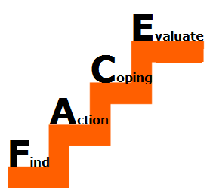
Problem solving
Think about the main problem you want to address, or the biggest worry that is stopping you from sleeping.
Think of as many solutions as you can – break these down into step (these can even be things that seem ridiculous!)
Pick the solution that you think is most suitable to start with
What will you need to do, bring with you, and what could get in the way?
It can be helpful to have a plan for if things don’t go how you think they will
Try it out! How did it go?
Notes:
On your own or with someone – talk through what the nature of the worry is, and think of as many things as you can to try and solve this – include even the ideas that seem like they wont work. Write everything down!
Once you pick a solution – be prepared for any situation, what could go wring, what will you need to do, when, what will you bring?
Action your chosen solution - if it worked, apply this to other worries that may be keeping you awake. If not, go back to your plan and think what may not have worked, and what else you could try?

Slide 32
Helpful resources
Getselfhelp.co.uk
Sleepcouncil.org.uk
Relax meditation app – sister app Relax Melodies allows you to build soundscapes
CAMHS sleep hygiene booklet
Headspace – Offers guided meditation to combat stress, anxiety, and sleep. Sign up and the first 10 sessions are free
Pzizz app – uses a mixture of soundscapes, voiceovers and personalised alarms to help you drift to sleep and wake up feeling refreshed.
Smiling mind app – mindfulness app broken down into modules by age range

Slide 33
Thank you
Any questions?
Please fill in the feedback form
Add your goal at the bottom and rate out of ten

