Slide 1
Mental Health Support for Hertfordshire’s Young People, Parents and Care givers at a glance
Mental Health Support for Hertfordshire’s
Children, Young People, Parents and Caregivers

Slide 2
With Youth Digital Wellbeing Service for 5-18s

Slide 3
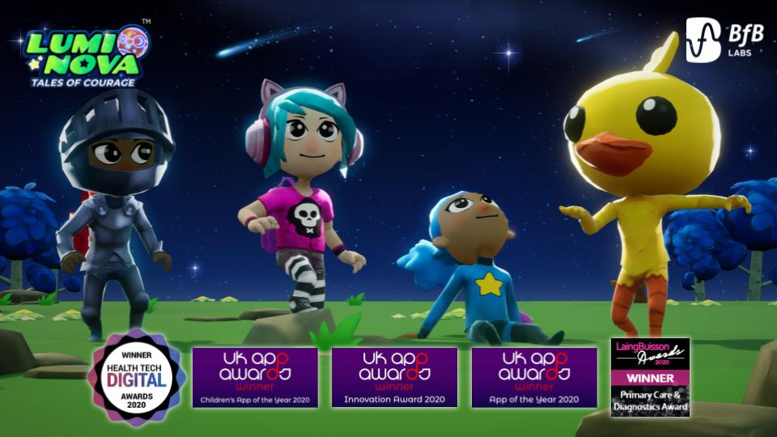
Lumi Nova Free Therapeutic Digital Gaming App for 7-12s
Fun & Free Therapeutic Gaming App for ages 7-12 to help with Hertfordshire children’s fears & worries
www.withyouth.org

Slide 4
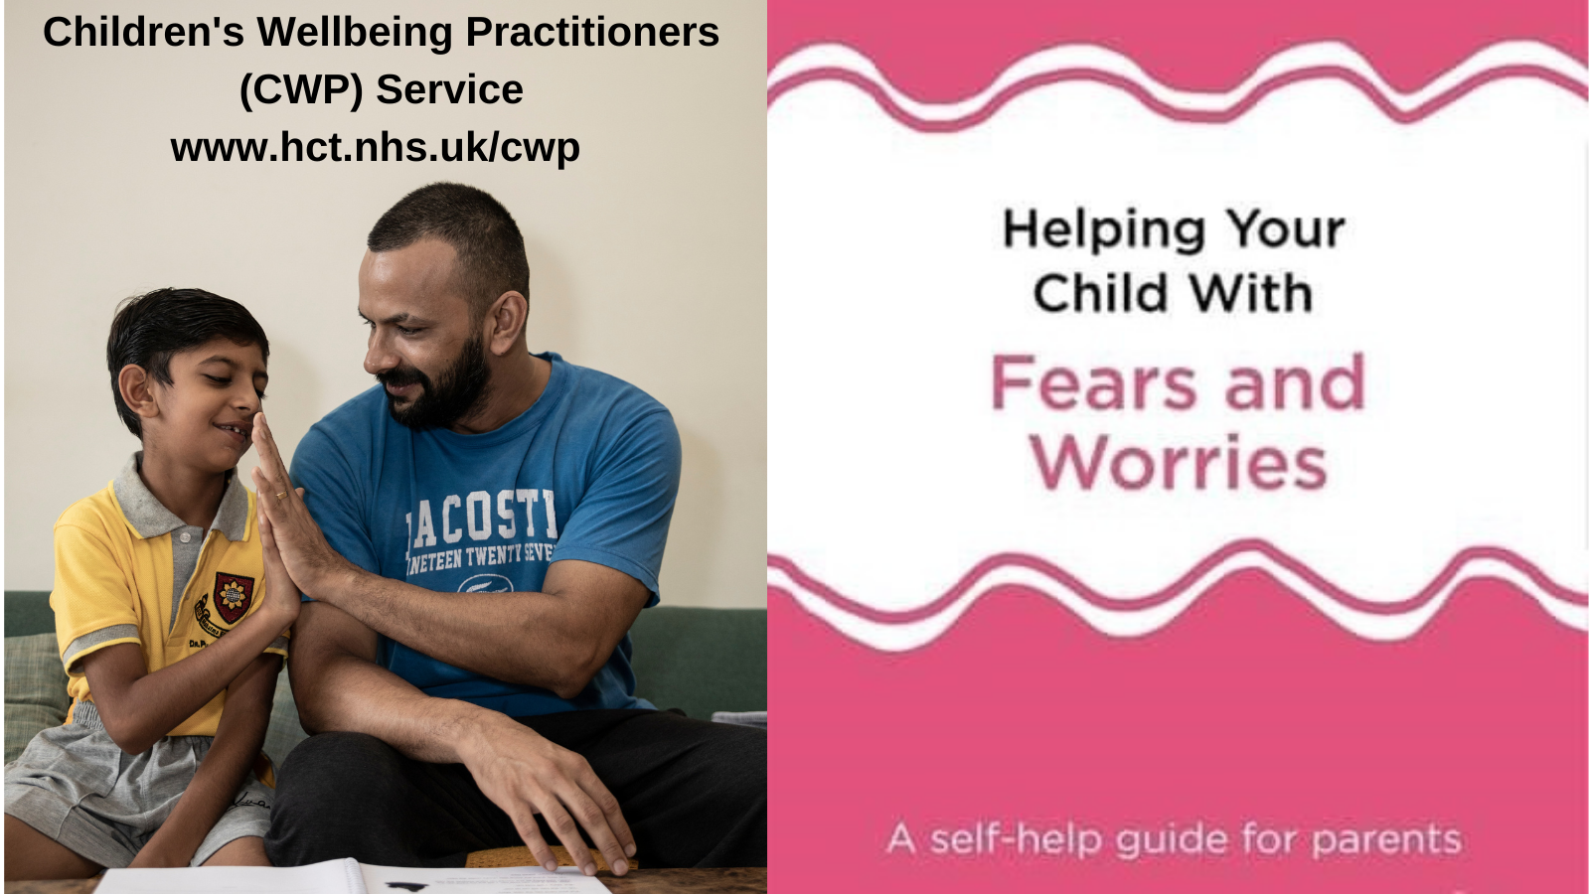
Children’s Wellbeing Practitioner Service for children and young people ages 5-19

Slide 5
Mental Health Support Teams in Schools (MHSTs)
Mental Health Support Teams (MHSTs)
are in more & more Herts schools & colleges…
Ask your school/college if they have a
Mental Health Support Team

Slide 6
Kooth Online Wellbeing Community for ages 10-25
If you’re age 10-25 and feeling worried, anxious, stressed or frustrated,
get some support at:
www.kooth.com

Slide 7
Just Talk Herts is there to help you find the support you need
If there’s something on your mind, Talking Shows Strength

Slide 8
Try Just Talk’s Five Ways to Wellbeing E-Learning Modules

Slide 9
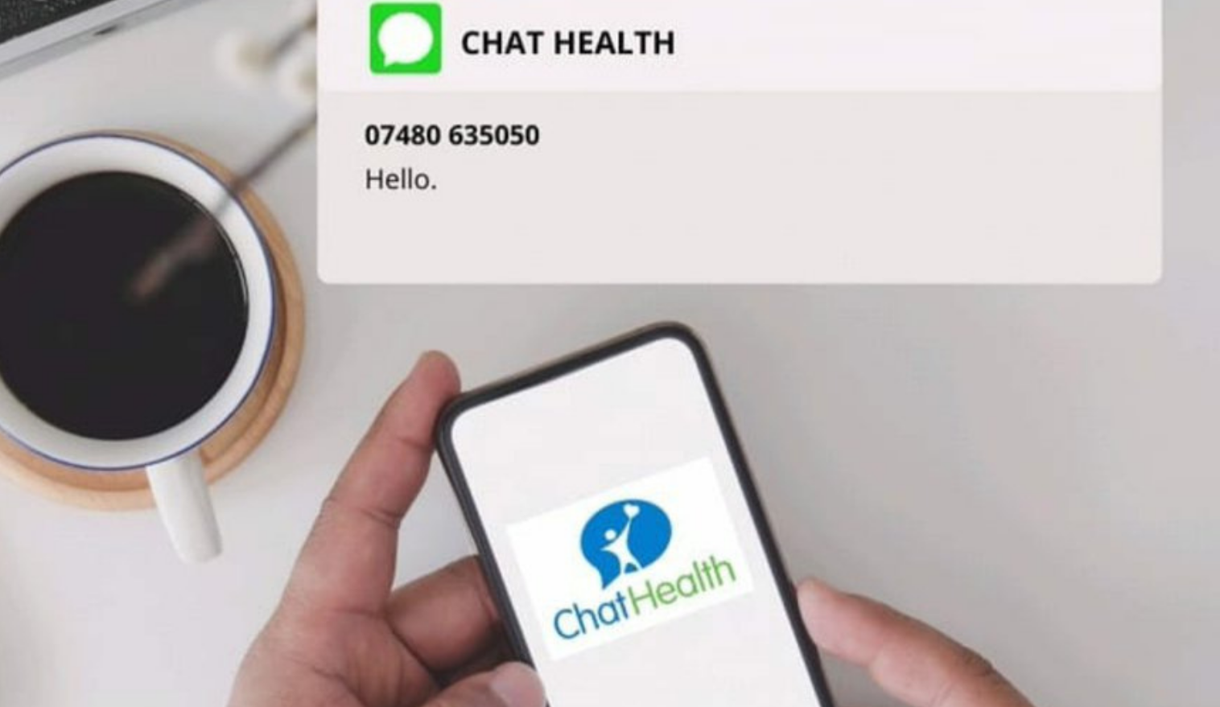
ChatHealth text messaging service for 11-19s
It’s easy for 11-19s to text a School Nurse at ChatHealth
for confidential & safe wellbeing advice

Slide 10
Herts Service for Young People
Information, advice, guidance,
work related support, emotional wellbeing support, sexual health & more for young people at:
0300 123 7538

Slide 11
First Steps to Understanding Eating Disorders or Eating Difficulties Services for Young People, Parents, Caregivers, Older Siblings
First Steps to Understanding Eating Disorders can help 5-18s in Hertfordshire via self, parent/carer or professional referrals
Call : 01332 367 571 or E: info@firststepsed.co.uk
www.firststepsed.co.uk

Slide 12
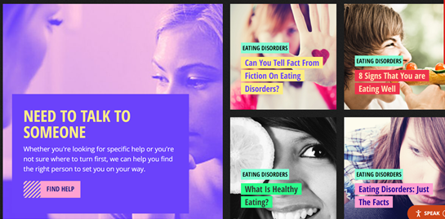
Health for Teens website
Healthy body & mind topics by experts for 11-19s at:
www.healthforteens.co.uk

Slide 13
Student Space website for mental health and emotional wellbeing of Uni students
Check out www.studentspace.org.uk
for mental health & emotional wellbeing articles, blogs, tips and advice for uni students

Slide 14
Just Talk Hertfordshire website for parents and carers
Mental health & emotional wellbeing info for Hertfordshire parents and carers at:
www.justtalkherts.org

Slide 15
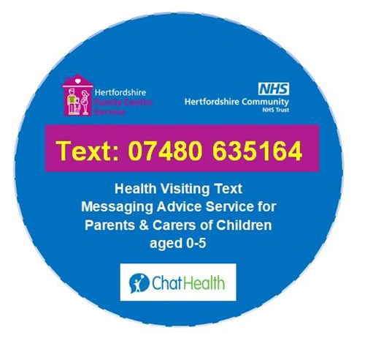
ChatHealth Text Messaging Service for parents and carers of children aged 0-5
Parents and carers of
0-5 year olds can get emotional health & wellbeing advice
from the Health Visiting Team via ChatHealth
text messaging service
Mon-Fri 9-5pm

Slide 16
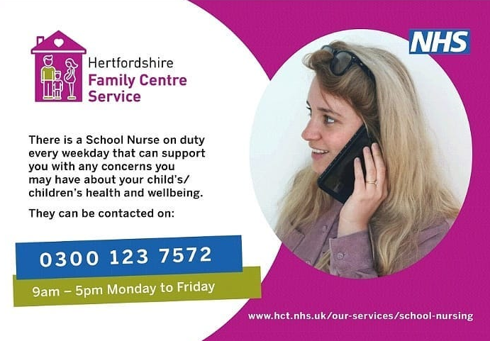
School Nursing Service number open Monday-Friday 9-5

Slide 17
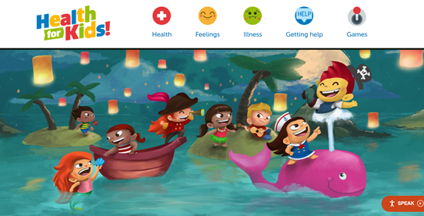
Health for Kids Website for Primary School Children
Healthy body & mind topics by experts for primary school children at:
www.healthforkids.co.uk

Slide 18
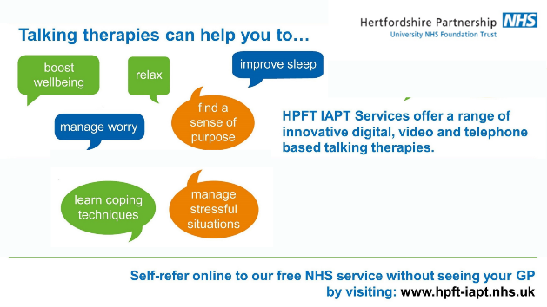
Talking Therapies for ages 16+ from HPFT’s Wellbeing IAPT Service
For people in Hertfordshire ages 16+

