Slide 1
Respiratory tract infections in children
Notes:
Welcome to this Wessex Healthier Together case based workshop on respiratory tract infections in children
This has been written by Paediatric Emergency Medicine clinicians and is geared towards the MDT working in Emergency Departments across Wessex
It will take between 30-45 minutes depending on the level of debate generated

Slide 2
Objectives
Develop understanding of presenting features, investigations and treatments of:
  Tonsillitis
  Otitis Media
  Pneumonia

Slide 3
Case 1: The child with a sore throat
History | Examination
3 year old boy (Milo) | Alert
2 days of fever | Well hydrated and perfused with normal HR, RR and sats
Reduced oral intake | Temp 38.5
Cough and runny nose | Red throat with exudate on tonsils
Previously well

Slide 4
What would you do?
Send home without antibiotics
Send home but provide a prescription to use if still unwell in 2 days
Send home with antibiotics
Admit for IVAbs
Notes:
Discuss for now – then look at some evidence and return to it later

Slide 5
How long is the pain likely to last?
2 days
4 days
6 days
8 days
10 days

Slide 6
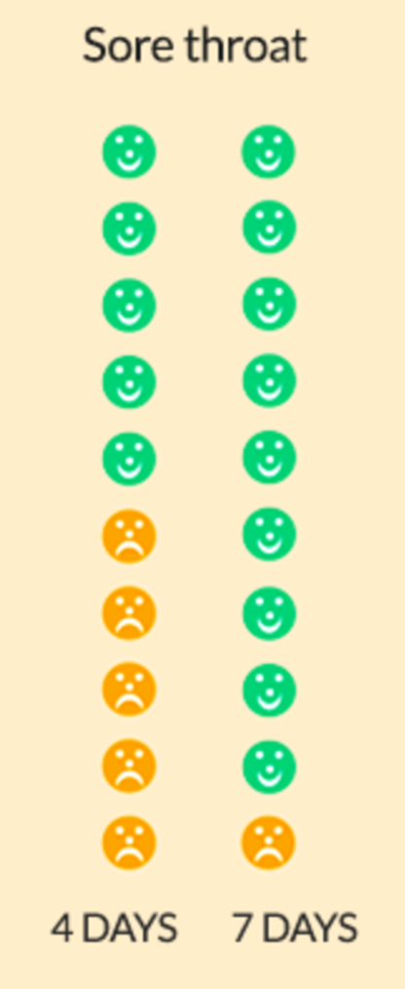
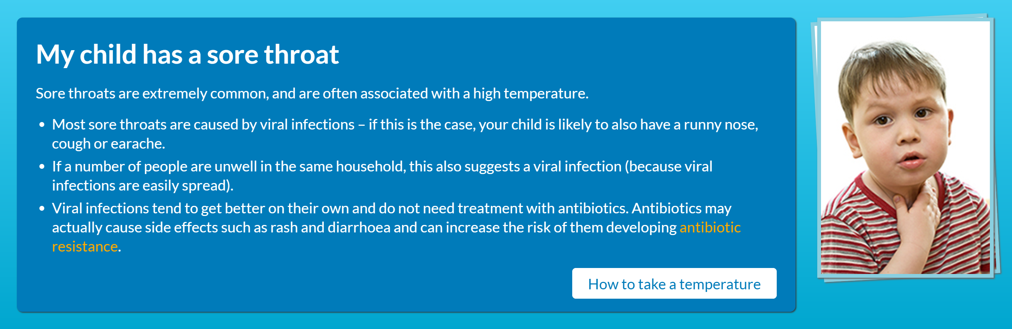
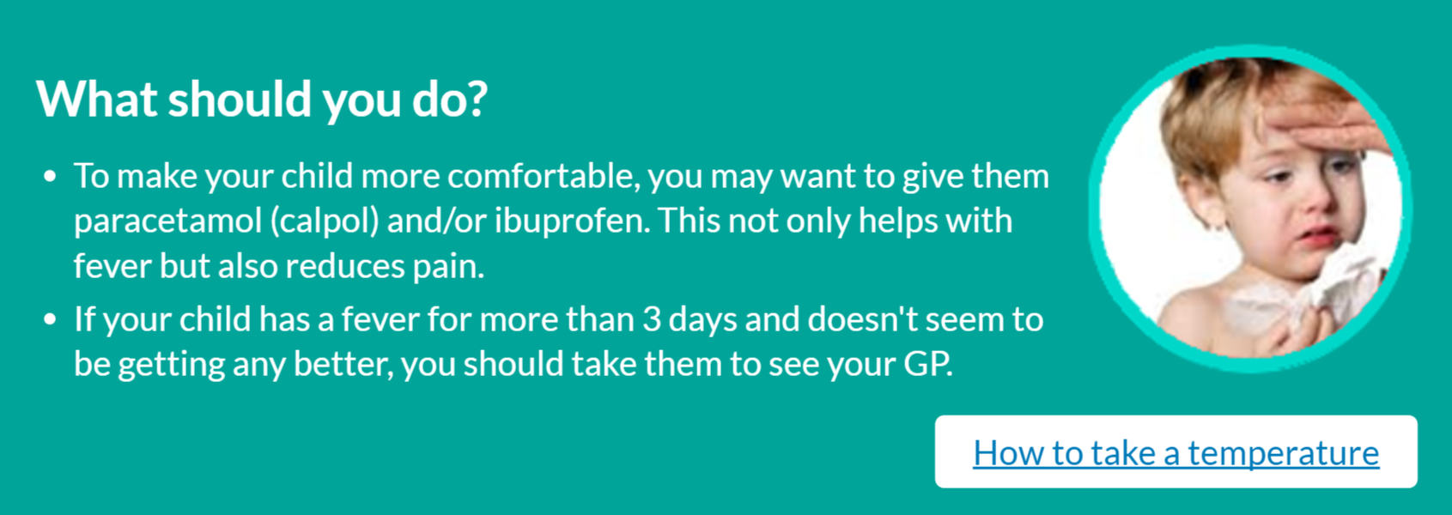
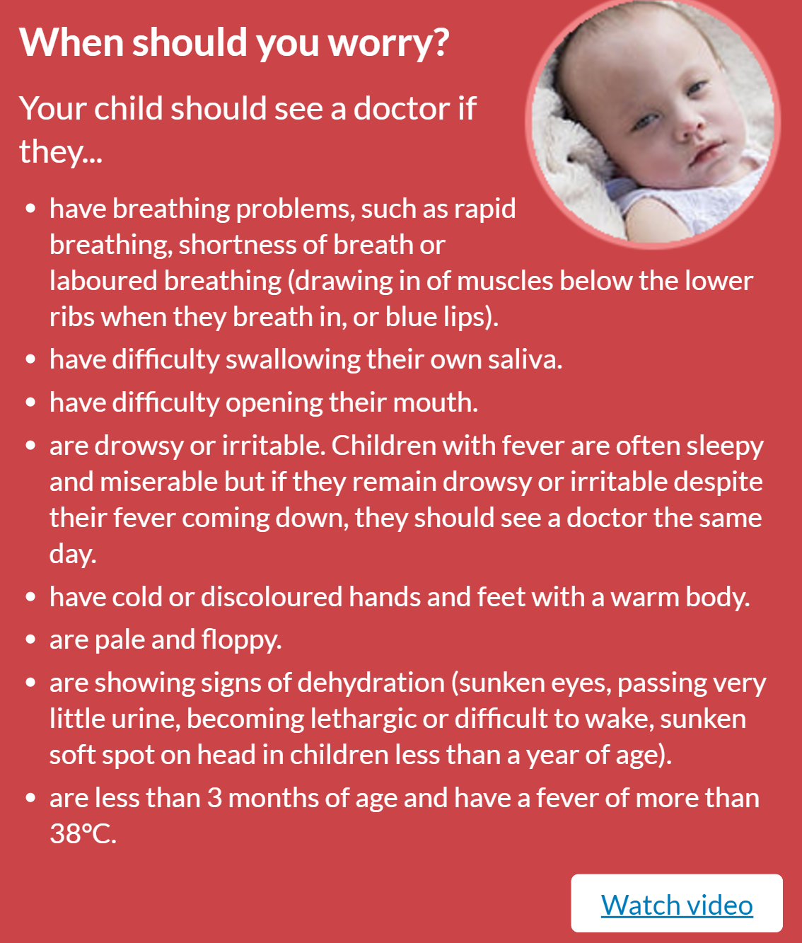
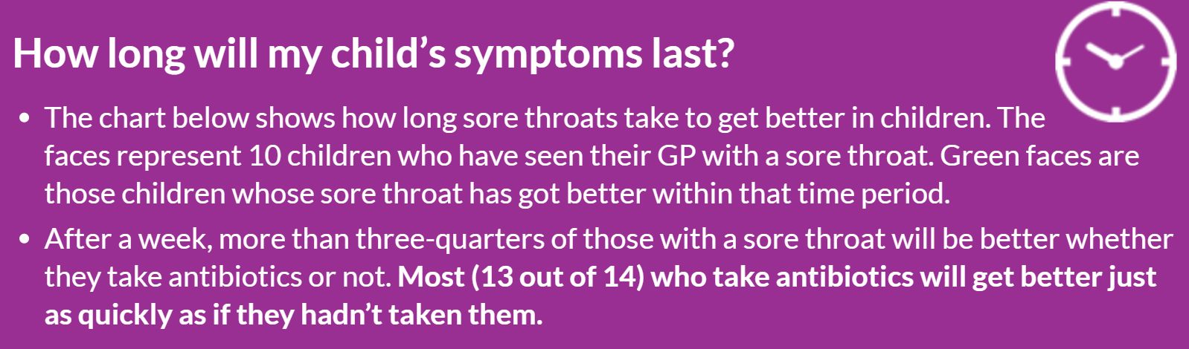
Notes:
50% pain free at 5 days, 90% at 7 days

Slide 7
Respiratory tract infections- why do we prescribe Abs?
Believe that the child will get better more quickly
  It is difficult to tell between viral and bacterial pathology. You think the child probably has a bacterial infection so treating will be better.
Significant concerns that ‘missing’ a bacterial infection will result in invasive bacterial infection / suppurative complications
  Should we be prescribing Abs “just in case”

Slide 8
Let’s look at some evidence...

Slide 9
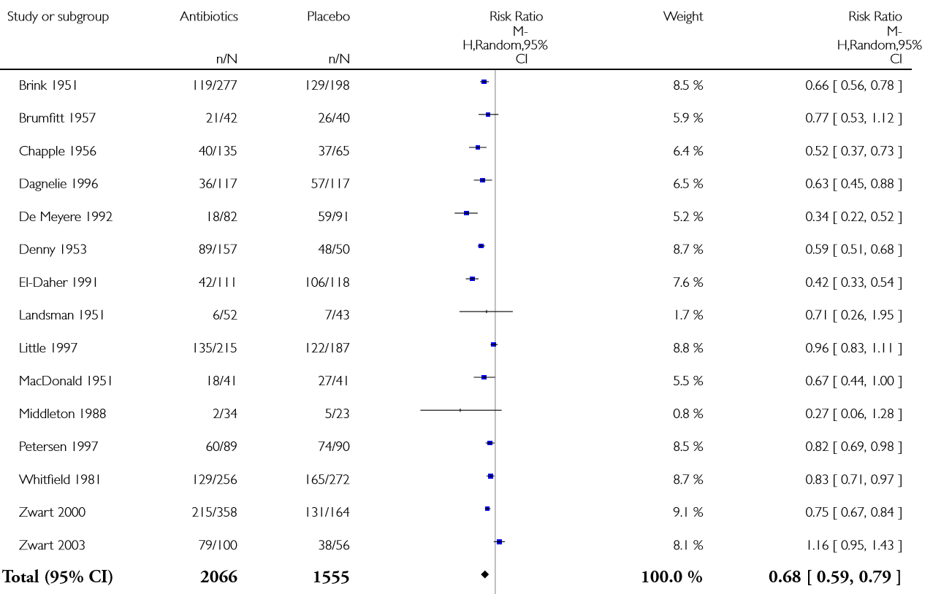
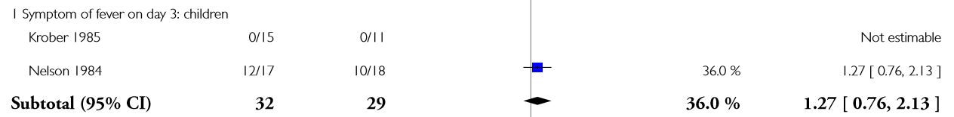
Implications of not treating tonsillitis – pain day 3
No difference in pain day 3 with antibiotics
Cochrane review, Antibiotics for people with sore throats, 2013

Slide 10
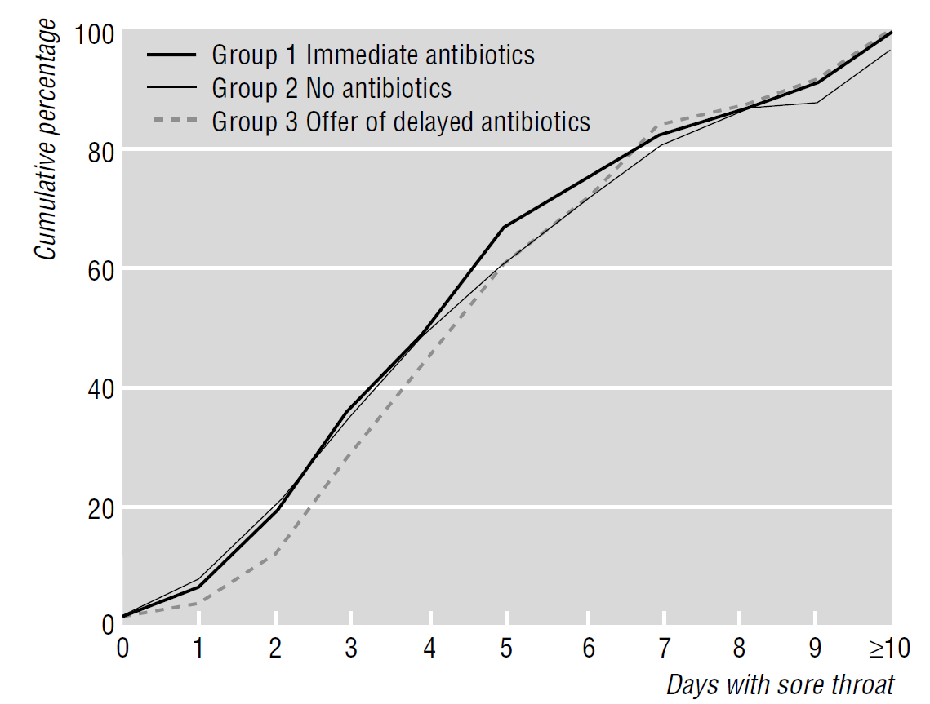
No difference in pain day 3 with antibiotics
N=716, patients aged ≥4 years of age
Little P et al. Open randomised trial of prescribing strategies in
managing sore throat. BMJ 1997

Slide 11
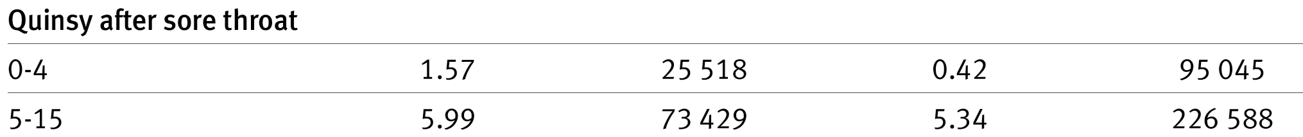
Risk of suppurative complications
To prevent an episode of quinsy, the NNT of acute sore throat with antibiotics is >4000
Peterson I at al. BMJ. 2007 Nov; 335:992-997

Slide 12
So – if most don’t need them how do we pick out the few that do?

Slide 13
National recommendations
FeverPAIN criteria
Fever (during previous 24 hours)
Purulence (pus on tonsils)
Attend rapidly (within 3 days after onset of symptoms)
Severely Inflamed tonsils
No cough or coryza
Each of the FeverPAIN criteria score 1 point (maximum score of 5).
Higher scores suggest more severe symptoms and likely bacterial (streptococcal) cause.

Slide 14
FeverPAIN – what to do?
Score | What it means | What to do
0-1 | 13 to 18% likelihood of streptococcus | Reassure and safety net
2-3 | 34 to 40% likelihood of streptococcus | Consider 48 hour delayed prescription of reassure and safety net
4-5 | 62 to 65% likelihood of streptococcus | Prescribe antibiotics
Most do not need a throat swab to confirm the diagnosis

Slide 15



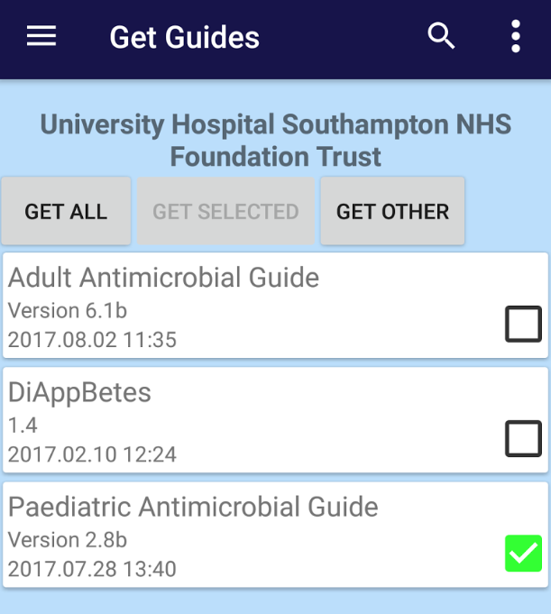
Choice of Abs
https://www.piernetwork.org/guidelines.html
Notes:
Navigate to the PIER guidelines page and show the guideline for first line therapy for childhood infections under the infectious diseases tab. Correct Abx on next slide

Slide 16
If you’re gonna do it, do it right...
Better taste – fewer administrations!
For children unable to swallow tablets; Amoxicillin 40mg/kg BD PO (max 1g per dose) for 7 days (2012 Cochrane review).
For children able to swallow tablets; if age 6-12 years, Penicillin V 500mg BD; if age >12 years, Penicillin V 1 g BD for 7 days
[Azithromycin PO if penicillin allergy for 5 days]

Slide 17
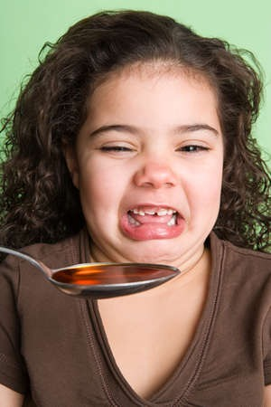
Choice of Abs
For children unable to swallow tablets, think about taste of suspensions:
  Flucloxacillin unpalatable!
  Pen V almost unpalatable
Risk of rash with amox/EBV small in children – use in place of traditional Pen V
  Lots get the rash anyway
  EBV rare in smaller children
7 days as good as 10 – no need for that second bottle

Slide 18
What about Milo?
History | Examination
3 year old boy (Milo) | Alert
2 days of fever | Well hydrated and perfused with normal HR, RR and sats
Reduced oral intake | Temp 38.5
Cough and runny nose | Moderately red throat with exudate on tonsils
Previously well
Fever PAIN score 3
Delayed script or reassure and SAFETY NET

Slide 19
But all families WANT antibiotics...

Slide 20
Why do parents bring their child to be seen?
It provides a proper ‘health-check’
Removes any ‘health-threat’
Parents lack confidence to distinguish self-limiting illnesses from serious ones but believe that clinicians can
  Parents do not generally seek Abs (but they are anxious!)
During a consultation, parents also seek info about:
  What to look out for / when to seek help
  What they can do to care for their child
Cabral C et al. Social science and medicine 2015

Slide 21
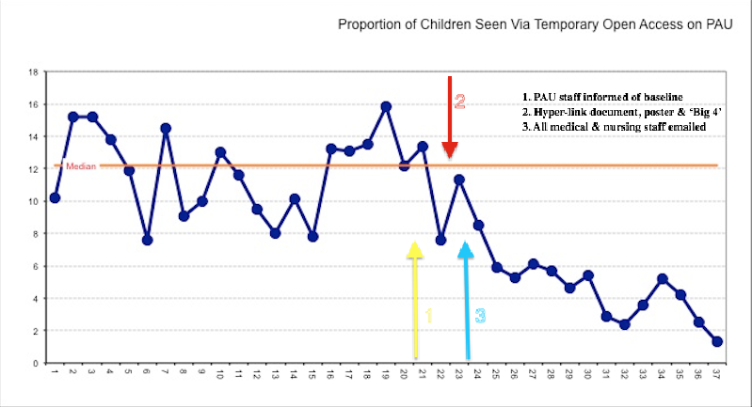
Impact of allaying anxiety / safety netting
Impact on primary care
Reduces re-consultation rate 12.9% versus 16.2%
Reduced Ab prescriptions 19.5% versus 40.8%
Impact on hospital patients
Notes:
Graph on right taken from Seb Gray QI project in Southampton. Demonstrates significant reduction in reattendance to a paediatric assessment unit when effective safety netting practice introduced

Slide 22
Navigate to WHT safety netting sheet for tonsillitis

Slide 23
Case 2: The child with earache
History | Examination
23 month old girl (Esme) | Alert
2 days of fever | Well hydrated and perfused with normal HR, RR and sats
Crying in pain | Temp 38.5
Reduced oral intake | Bilateral red bulging tympanic membranes
Previously well

Slide 24
What would you do?
Send home without antibiotics
Send home but provide a prescription to use if still unwell in 2 days
Send home with antibiotics
Admit for IVAbs
Notes:
Discuss for now – then look at some evidence and return to it later

Slide 25
A bit more evidence...

Slide 26
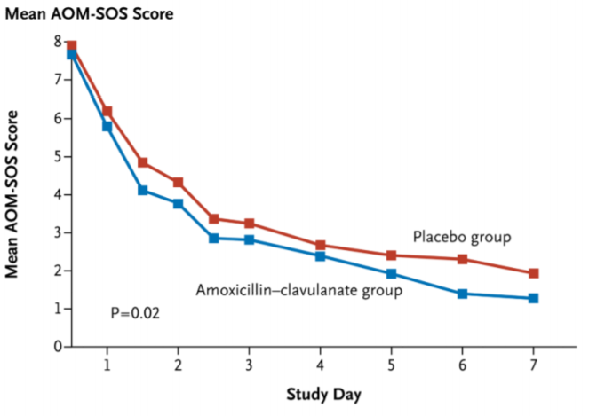
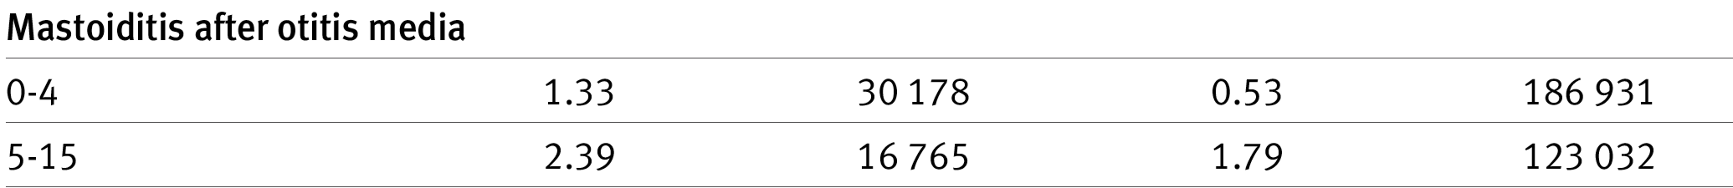
Implications of not treating OM
Very small improvement in symptom score
Hoberman A et al. Treatment of acute otitis media in children under 2 years of age. N Engl J Med. 2011 Jan; 364(2):105-115
NNT 4831 to stop one case of mastoiditis
Thompson PL et al. Pediatrics. 2009 Feb; 123(2):424-430.

Slide 27
Most children don’t need antibiotics so who does...
Age 6 months to 2 years
Bilateral OM
Unilateral OM and symptom score of >8 (0=no symptoms, 1=a little, 2=a lot) for the following criteria:-
  fever (>39 degrees = score of 2)
  tugging ears
  crying more
  irritability
  difficulty sleeping
  less playful
  eating less.
Age 6 months to 2 years
Symptoms for 4 days or more
Purulent discharge from ear canal (not due to otitis externa*)
Systemically unwell
Under 6 months of age with presumed acute OM.
* If ear discharge but systemically well and apyrexial, treat with topical antibiotics (sofradex or neomycin) for 10 days.

Slide 28
What to treat with?
Remember microguide and PIER regional guidelines
Amoxicillin PO for 5 days.
If failed treatment with amoxicillin , co-amoxiclav PO for 5 days
If IV treatment required, for ceftriaxone IV
[azithromycin PO if penicillin allergy]
In children with tympanostomy tubes in situ, data suggest that treatment with topical Abs is associated with lower rates of treatment failure than Tx with oral Abs - (Ahmed, ADC 2018)

Slide 29
What about Esme?
History | Examination
23 month old girl (Esme) | Alert
2 days of fever | Well hydrated and perfused with normal HR, RR and sats
Crying in pain | Temp 38.5
Reduced oral intake | Bilateral red bulging tympanic membranes
Previously well
Treat with 5 days amox
Provide SAFETY NET

Slide 30
Navigate to WHT safety netting sheet for otitis media

Slide 31
Case 3: The child with fever and cough
History | Examination
5 year old boy (Oleg) | Alert
3 days of fever | Well hydrated and perfused. HR 112 CRT<2s
Reduced oral intake | RR 36. No respiratory distress
Cough | Reduced air entry right base and crackles
Abdo pain

Slide 32
What would you do?
Investigations?
Treatment?
Notes:
Please use this time to discuss what investigations you would do in this case – clear signs of chest infection with no evidence of sepsis.
Discuss need for bloods (not indicated) and CXR – explore what a GP would do with this child. Just because we have the ability to perform a CXR doesn’t mean we need to!
Abx explored in next slides

Slide 33
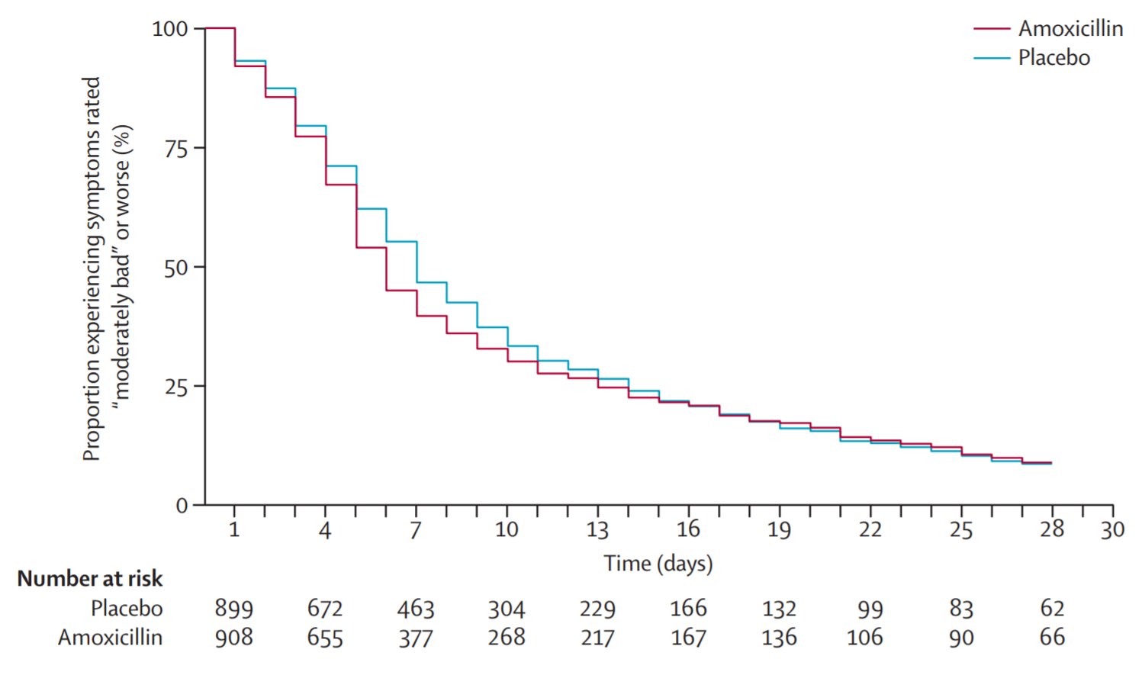
GRACE study – adults with LRTI in primary care
N=2051
RCT of amox versus placebo in children with LRTI currently recruiting (ARTIC PC)
Notes:
Again – relatively little improvement if at all for most with Abx but most evidence is from adults.

Slide 34
Pneumonia
Most lower respiratory tract infections are of viral aetiology
Consider bacterial pneumonia if persistent/recurrent fever over preceding 24-48 hours with tachypnoea/resp distress.
Presence of generalised wheeze >1y or crackles <1y makes viral aetiology far more likely.
Hypoxia and increased work of breathing are better indicators of pneumonia than tachypnoea and auscultatory findings (Shah SN, JAMA 2017)

Slide 35
Pneumonia
Moderate:
  amoxicillin PO (or co-amoxiclav PO if no response to amoxicillin)
If severe or complicated pneumonia (O2 sats<85%, haemodynamic instability/septicaemia, immunocompromised, chronic lung disease, congenital heart disease, empyema, necrotising pneumonia):
  < 1 month of age treat with cefotaxime IV. Consider ceftriaxone IV if ≥37 weeks gestation and not jaundiced.
  1-3 months of age: ceftriaxone IV
  ≥3 months of age: amoxicillin IV. If IV access issues or option for ambulation (and oral switch not appropriate), consider ceftriaxone IV
Notes:
Again – remind that all doses/drugs can be found on microguide or regional PIER guideline

Slide 36
Navigate to WHT safety netting sheet for cough

Slide 37
Case 4: The more unwell child
History | Examination
7 year old girl (Maddie) | Alert but very quiet
5 days of fever | HR 146 CRT 4s Cold peripheries
Reduced oral intake | RR 40. Mild tracheal tug/recession
Cough | Reduced air entry right base and crackles
Increasingly sleepy

Slide 38
Treatment
ABCDE
Bloods, gas, XR
IV fluid resusitation
IV antibiotics as per microguide/PIER
SORT sepsis guideline
Notes:
Navigate to the SORT sepsis guideline

Slide 39
A little note on Penicillin allergy
Most children labelled with a penicillin allergy are not allergic to penicillin
  Implications re lifelong label
  Features suggestive of a penicillin allergy (type 1 hypersensitivity):
    Timing post Ab
    Symptoms: urticaria, angio-oedema, anaphylaxis
    NOT genetic / not familial
    True penicillin allergy rare in childhood

Slide 40
Summary
Move away from the bacterial / viral paradigm
  Make decisions based on severity of illness instead
Be clear about what the benefits of Abs really are
Align the consultation with the parent’s expectations
  Reassure them (and yourself!) that there child is not severely ill by examining + checking basic physiological parameters – HR/RR
  Articulate severity in terms of red/amber/green flags
  Use standardised antibiotic guidelines – microguide/PIER
  Consistent safety netting
www.what0-18.nhs.uk

Slide 41
A bit about Wessex Healthier Together
Website and app with resources for common childhood acute presentations for families, GPs, pharmacists, child health nurses and Emergency Departments as well as wellbeing resources for young people.
Clinical pathways and safety netting sheets for:
Bronchiolitis | Asthma | Fever | Head injury | Lymphadenopathy
Viral wheeze | D&V | Limp | Abdo pain | UTI
Thank you for attending a Wessex Healthier Together Emergency Department workshop. If you have any questions or suggestions please email: David.james@uhs.nhs.uk or alan.charters@porthosp.nhs.uk
Notes:
Please finish on this slide.
We are keen to promote the use of Wessex Healthier Together as the go to resource for health advice for common conditions seen in Children’s ED. Please get in touch with comments and suggestions both on the workshops but also on the pathways and if you would like to get involved in pathway design or revision.

