Slide 1
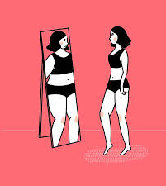
EATING DISORDER & BODY IMAGE
DR ALISON COWAN

Slide 2
WHO AM I?
GP
HVCCG: 3-4 x weekly standard GP surgeries and 1 x YPC
HPFT: Weekly GP review clinic for CAMHS Community Eating Disorder Service
CAHMS GP Lead for Hertfordshire
Mum to 3 teenage girls

Slide 3
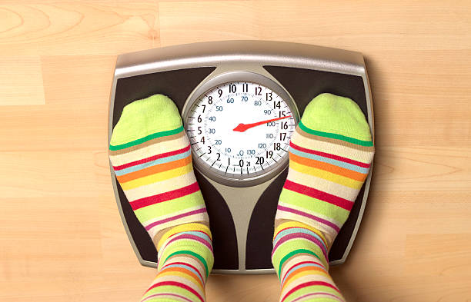
LEARNING OUTCOMES
PART 1
Overview of Eating Disorder (ED)
Epidemiology
Current prevalence rates
Aetiology
Prognosis
Main types and core characteristics
Body Image and social media
PART 2
GP assessment of body image concern or suspected ED
Baseline risk assessment
Identification of red flags
GP management of body image concern or suspected ED

Slide 4
EPIDEMIOLOGY
Prevalence
0.2-13.1% prevalence across the world
1.6 million people in UK (2015)
Average GP list size of 2,000 patients
1-2 patients anorexia
18 patients bulimia
10% young female patients weight reduction techniques
Highest % in 14-25yr age group
ED more common in girls
Anorexia most common ED in adolescence

Slide 5
AETIOLOGY
Biological
Genetic vulnerability
Pubertal changes
Type 1 diabetes
Sociocultural
Social media
Negative family relationships
Psychological
Poor self-esteem
Perfectionism
Guilt and shame
Low mood
Anxiety

Slide 6
COMORBIDITIES
Depression: 50-75% ED patients
Personality Disorders: 50-75% ED patients
Substance abuse:
30-37%: Bulimia Nervosa patients
8-12%: Anorexia Nervosa patients
Bipolar disorder: 25% Anorexia Nervosa patients
Self-harm: 54% patients have an ED
OCD: 4-6% ED patients
THINK EATING DISORDER IN ALL PRESENTATIONS WITH MENTAL ILLNESS

Slide 7
PROGNOSIS
POOR
50% full and sustained recovery at 5 years
10% mortality
80% due to physical causes
20% due to suicide
BUT SIGNIFICANTLY IMPROVES WITH EARLY RECOGNITION AND TREATMENT

Slide 8
MAIN ED TYPES AND CHARACTERISTICS
Anorexia Nervosa (AN)
15% of all ED
Most common in adolescence
Bulimia Nervosa (BN)
Binge Eating Disorder (BED)
Most common in men
Other Specified Feeding and Eating Disorders (OSFED)
Highest % currently presenting in context of COVID-19

Slide 9
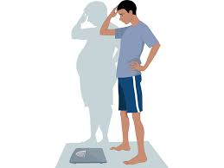
ANOREXIA NERVOSA
15% of all ED but most common in adolescence
Peak age of onset: 13-18yr
Characteristics
Weight loss or failure to gain weight as a result of restriction
Low body weight
Restriction of food )
Self-induced vomiting ) compensatory behaviours
Excessive exercise )
Medication misuse )
Disturbance in body image )
Intense body-related anxiety or shame and low self-esteem ) overevaluation
Intense fear of gaining weight or becoming fat ) of importance
Preoccupation with weight/shape/food ) of shape/weight

Slide 10
ANOREXIA NERVOSA: impact

Slide 11
BULIMIA NERVOSA
Peak age of onset: 15-19yrs
Characteristics:
Recurrent episodes of binge eating and inappropriate compensatory behaviours to prevent weight gain
Weight generally in normal range
Episodes occurring at least 1 x week for 3 months
Binge eating: consumption of unusually large volumes of food in a brief period of time with feelings of loss of control and shame and guilt
Compensatory behaviours: Vomiting, exercising, medication misuse or fasting
Overevaluation of importance of shape and weight

Slide 12
BULIMIA NERVOSA: impact

Slide 13
BINGE EATING DISORDER
Peak onset: early adult life
43% BED men
Characteristics
Recurrent and persistent episodes of binge eating without purging
Episodes occurring at least 1 x week for 3 months
Binge eating: consumption of unusually large volumes of food in a brief period of time with feelings of loss of control, shame, guilt and distress
Absence of regular compensatory behaviours
Usually no abnormal body-related cognitions

Slide 14
OSFED Other Specified Feeding and Eating Disorders
Increasing prevalence during COVID-19
Doesn’t fit the diagnostic criteria of AN/BN/BED
Types
Atypical AN: all the characteristics of AN are present,
but the person is not significantly underweight
Purging disorder: shares many features of BN but no binge-eating episodes
Avoidant Restrictive Food Intake Disorder (ARFID): umbrella term to encompass several presentations which are not about weight or shape.

Slide 15
BODY IMAGE
“Body image is how we think and feel about ourselves physically, and how we believe others see us’’
Body image dissatisfaction is commonest risk factor for ED
Social media: direct link between hours spent on social media and increased body dissatisfaction
Insta-Lie https://www.youtube.com/watch?v=0EFHbruKEmw
Resources
PIL to give out to young people and parents
Local resources
National websites
Embedded leaflets
Chest binding
Social Media

Slide 16
PART 1 KEY LEARNING POINTS
Eating disorders are common and increasing, especially in adolescents
Anorexia is the most common ED in adolescence
Poor self-esteem and body image are key risk factors
Characterised by shame and secretive behaviours so often played down
Need open, non-judgemental and non-blaming approach
Consider non-eating related symptoms as well as eating-related symptoms
In particular mental ill health
Carries highest mortality of any mental health condition
Secondary to physical state and suicidal behaviours
Important to take seriously and ensure a comprehensive physical and mental health risk assessment

Slide 17
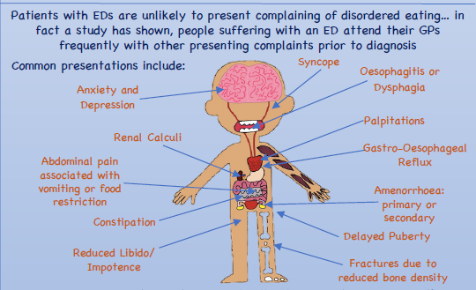
PART 2: ED ASSESSMENT AND EARLY MANAGEMENT

Slide 18
SUSPICION OF ED
EDs are defined by abnormal thoughts and feelings
Tease out diagnosis with questions around
Preoccupation with food/weight/shape
Control (or lack of it)
Purging (Restrictive and compensatory behaviours)
Secretive behaviours
Other mental health symptoms: comorbidities
Encapsulated in SCOFF questionnaire
BE AWARE THE NATURE OF ED IS TO DECEIVE SO LOW THRESHOLD TO REFER

Slide 19
SCOFF QUESTIONNAIRE

Slide 20
LIKELY EATING DISORDER
Baseline Risk Assessment
Physical health parameters
Weight indicators
General examination findings
Cardiovascular health
Hydration status
Temperature
Muscle weakness
Blood tests
ECG findings
Disordered ED Behaviours
Engagement
Mental health risk assessment
Initial management and referral
URGENT ASSESSMENT AND REFERRAL OF HIGH RISK PATIENTS

Slide 21
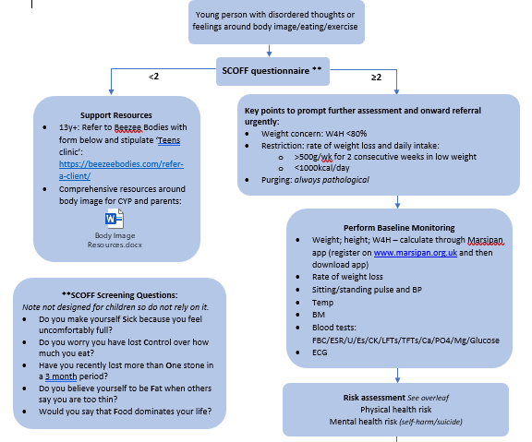

Slide 22
WEIGHT PARAMETERS
 | RED | AMBER | GREEN
Weight
<18yr: Median % BMI (W4H age adjusted BMI) www.marsipan.org.uk | <70% | 70-80% | >80%
>18yr: BMI | <13 | 13-14.9 | >15
Weight loss in low weight patients | ≥ 1kg/week for 2 weeks | 500-999g/week for 2 weeks | < 500g/week for 2 weeks

Slide 23
CARDIOVASCULAR HEALTH
Cardiovascular health
Heart rate (awake) | <40bpm | 40-50bpm | >50bpm
Standing BP | <0.4 centile for age <90 systolic if 18+yr with recurrent syncope and | <0.4 centile for age 84-98/35-40 <90 systolic if 18+yr with occasional syncope and | Normal standing BP for age and gender and normal heart rhythm and
Drop in BP on standing | >20 | >15/10 mmHg | Normal orthostatic changes
Rise in pulse on standing | >30bpm (>35 in <16yrs) or | Up to 30bpm (35 in <16yr) or

Slide 24
BM HYDRATION STATUS and TEMPERATURE
BM | <3 | <4 | >4
Temp | <35.5 tympanic; 35.0 axillary | <36 | >36
Hydration Status
Urine output; dry mouth; postural changes; skin turgor; sunken eyes; P; RR | Fluid refusal Severe dehydration 10% | Severe fluid restriction Moderate dehydration 5-10% | Minimal fluid restriction Mild dehydration only <5%

Slide 25
MUSCULAR WEAKNESS
Muscular weakness
SUSS Test Part 1: Sit up from lying flat | Unable to sit up from lying flat at all (0) or without using hands (1) | Unable to sit up without noticeable difficulty (2) | Sits up from lying flat without any difficulty (3)
SUSS Test Part 2: Stand up from squat | Unable to get up from squatting at all (0) or without using hands (1) | Unable to get up without noticeable difficulty (2) | Stands up from squat flat without any difficulty (3)

Slide 26
DISORDERED EATING BEHAVIOURS
Disordered eating behaviours
Restriction | Acute food refusal or calorie <500kcal for 2 or more days | Severe restriction <50% required intake (<1000kcal) | Moderate restriction
Purging behaviours | Multiple daily episodes | 3 x week
Exercise in malnutrition | >2h/day uncontrolled exercise | >1h/day uncontrolled exercise | <1h/day
Engagement | Physical resistance | Poor insight and some resistance | Some insight

Slide 27
RED FLAGS
BMI <13 (adults) mMBI <70% (<18yrs)
Recent loss of >1kg for 2 consecutive weeks
Pulse <40 (snack and water pulse <50)
Low Systolic BP (18+ < 90) (snack and water <90/50)
BP postural drop >20mm Hg or postural pulse increase > 30bpm (>35bpm if <16yrs) or dizziness (snack and water postural drop >15mmHg)
Core temperature <35.5
Acute food or fluid refusal/intake < 500kcal/day
BM < 3.0 (snack and water if BM < 4.0)
SEND TO A/E FOR BTS AND ECG AND REFER URGENTLY TO CEDS
IF A NUMBER OF AMBER RISK FEATURES CONSIDER A/E

Slide 28
ECG ABNORMALITIES
ECG: females (F); males (M) | <18yrs QTc >460ms F; >400ms M 18+yrs QTc >450ms F;>430ms M and any other ECG abnormality | <18yr: QTc >460ms F;>400ms M >18yrs: QTc >450ms F; >430msM No other ECG abnormality Meds that prolong QTc | <18yr: QTc <460ms F; <400ms M >18yrs: QTc <450ms F; <430ms M

Slide 29
BLOOD TESTS
ESPECIALLY IF VERY LOW WEIGHT OR PURGING
U/ES
CK
LFTs
GLUCOSE
FBC
BONE PROFILE
CALCIUM
PHOSPHATE
MAGNESIUM
TFTS and ESR: to rule out other conditions

Slide 30
BLOOD TESTS
Biochemistry Blood Tests | Hypokalaemia <3.0mmol/l | <3.5mmol/l | >3.5mmol/l
 | Hyponatraemia <130mmol/l | <135mmol/l | >135mmol/l
 | Hypophosphataemia <1mmol/l (adolescents) <0.8mmol/l (adults)
 | Hypocalcaemia
 | Transaminases x 3ULN
 | Hypoalbuminaemia <32 | <35 | >35
 | Hypoglycaemia <3mmol/l | <4.0mmol/l | >4.0mmol/l
 | In Diabetes HbA1C >10%
Haematology Blood Tests | Low White Cell Count <2.0 | < 4.0 | >4
 | Haemoglobin <10g/l | <11g/l | >11g/l
URGENT REFERRAL OF ANY RED OR AMBER RISK PATIENTS

Slide 31
MENTAL HEALTH RISK and ENGAGEMENT
Engagement | Physical resistance | Poor insight and some resistance | Some insight
Self-harm and suicide | Self-poisoning and high risk of completed | Cutting and low risk of completed suicide

Slide 32
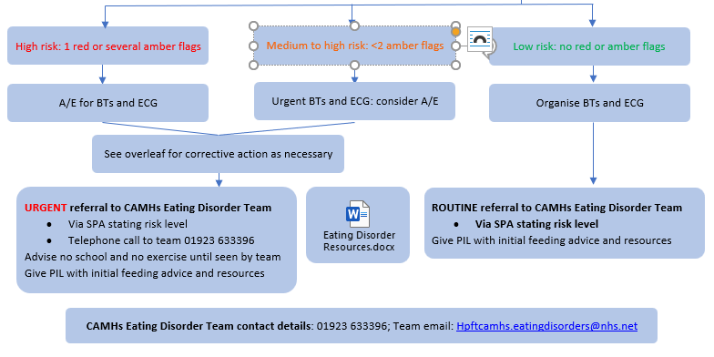

Slide 33
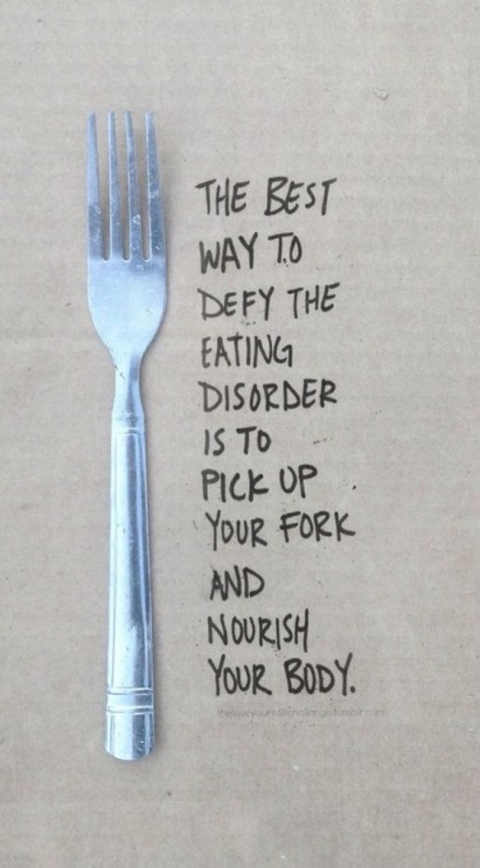
INITIAL MANAGEMENT
Detailed in the PIL: link
Grave Concern: Minnesota experiment
No school or exercise if any red or amber flags
Importance of taking control – firm but understanding
Guidance around meals
3 regular meals and 2 snacks
Stay with them for 1 hour after eating if vomiting a risk
Distraction during and after meals
Self-care
Support resources

Slide 34
CASE STUDY VK
17yr old girl presenting with anxiety and low mood
Denied any impact on eating pattern but admitted to maternal concerns
Had become amenhorreic but denied any other physical symptoms
Exercised daily; no other compensatory behaviours
Baseline physical health assessment
W4H: 77%
Pulse: 42 bpm
BP 90/70; no orthostatic changes
Normal temperature and BM
Referred to A/E for BTs and ECG
Referred urgently to CAMHS CEDS – seen the next day
Advised no school or exercise until seen by the team
Reiterated grave concern and initial management
3 AMBER RISK FACTORS = HIGH RISK

Slide 35
PART 2 KEY LEARNING POINTS
Enquire about ED thoughts with any CYP MH presentation
Further assessment if any suspicion of ED
F2F baseline risk assessment is critical for patient safety
Immediate management
Speed of referral
To share important support resources
Assess ASAP if any of the following in the history
Significant restriction or weight loss; Purging
Refer if abnormal thoughts around eating irrespective of baseline data
If unsure discuss with CAMHS Duty Worker on 01923 633396

Slide 36
SUMMARY OF STEPS 1

Slide 37
SUMMARY OF STEPS 2

Slide 38
alison.cowan@nhs.net
https://hwehealthiertogether.nhs.uk/professionals/gp-primary-care-staff

